Slide 1
Intro to Deep Learning with Keras
Data Science FORUM

Slide 2
Definition
Deep Learning is a subfield of machine learning concerned with algorithms inspired by the structure and function of the brain called artificial neural networks.
Deep learning is the fastest-growing field in machine learning. It uses many-layered Deep Neural Networks (DNNs) to learn levels of representation and abstraction that make sense of data such as images, sound, and text.

Slide 3
Application of Deep Learning
Image recognition and classification
Speech recognition
Language translation
Medical diagnostics (x-rays, retina disease)
Self driving cars
Games (poker, Go, video games)
Music and art

Slide 4
Prerequisites
Learn Python
Use Anaconda https://anaconda.org/anaconda/python
Get machine with GPU. Deep learning on CPU is 10 to 100 times slower
Nvidia CUDA https://developer.nvidia.com/cuda-downloads
CUDNN https://developer.nvidia.com/cudnn

Slide 5
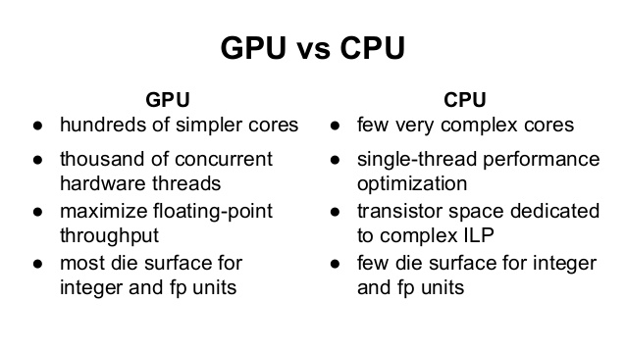
CPU vs GPU

Slide 6
Libraries
TensorFlow (Google)
Apache MXNet (Amazon)
CNTK (Microsoft)
Torch/Pytorch (Facebook)
Theano (University of Montreal)
Caffe2

Slide 7
Keras
Keras is a high-level neural networks API, written in Python and capable of running on top of TensorFlow, CNTK, or Theano. It was developed with a focus on enabling fast experimentation. Being able to go from idea to result with the least possible delay is key to doing good research.
Developed by François Chollet as part of the research effort of project ONEIROS (Open-ended Neuro-Electronic Intelligent Robot Operating System). Now at Google

Slide 8
Guiding principles
User friendliness. Keras is an API designed for human beings, not machines. It puts user experience front and center. Keras follows best practices for reducing cognitive load: it offers consistent & simple APIs, it minimizes the number of user actions required for common use cases, and it provides clear and actionable feedback upon user error.
Modularity. A model is understood as a sequence or a graph of standalone, fully-configurable modules that can be plugged together with as little restrictions as possible. In particular, neural layers, cost functions, optimizers, initialization schemes, activation functions, regularization schemes are all standalone modules that you can combine to create new models.
Easy extensibility. New modules are simple to add (as new classes and functions), and existing modules provide ample examples. To be able to easily create new modules allows for total expressiveness, making Keras suitable for advanced research.
Work with Python. No separate models configuration files in a declarative format. Models are described in Python code, which is compact, easier to debug, and allows for ease of extensibility.

Slide 9
Functionality
Layers (Convolutional, Pooling, Recurrent, Embedding, etc)
Activation functions (relu, softmax, tahh)
Optimizers (RMSprop, Adam, SGD, etc)
Text and image preprocessing
Applications (pre-built and pre-trained models)
Scikit-learn compatability
Multi-GPU and Multi-Node support (on Tensorflow backed)

Slide 10
Additional Resources
Fast AI (Practical Deep Learning For Coders)
http://course.fast.ai/
Coursera Deep Learning by Andrew Ng
https://www.coursera.org/specializations/deep-learning
Udemy Deep Learning Course
https://www.udemy.com/deeplearning/
Courses comparison
https://medium.com/towards-data-science/thoughts-after-taking-the-deeplearning-ai-courses-8568f132153
Safari Live training
https://www.safaribooksonline.com/live-training/

Slide 11
Resources
Deep Learning with Python by Francois Chollet https://www.manning.com/books/deep-learning-with-python

